Slide 1
AVL Tree

Slide 2
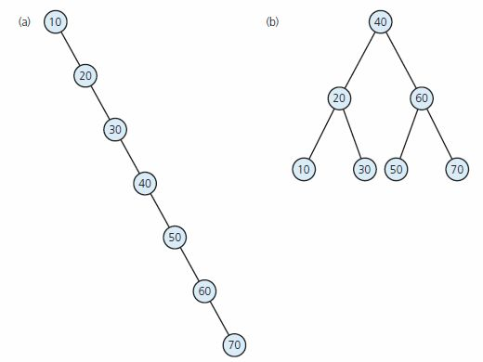
Problem with BST?
BST are fast if they’re shallow.
Problems occur when one branch is much longer than the other.
A binary search tree of maximum height
a binary search tree of
minimum height

Slide 3
Types of Trees
trees
static
dynamic
game trees
search trees
priority queues
and heaps
graphs
binary search
trees
AVL trees
2-3 trees
tries
Huffman
coding
tree

Slide 4
AVL Tree is…
named after Adelson-Velskii and Landis
the first dynamically balanced trees to be propose
Binary search tree with balance condition in which the sub-trees of each node can differ by at most 1 in their height

Slide 5
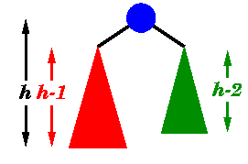
An AVL tree has the following properties:
Sub-trees of each node can differ by at most 1 in their height
Every sub-trees is an AVL tree

Slide 6
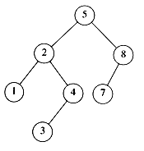
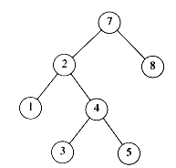
AVL tree?
YES
Each left sub-tree has height 1 greater than each right sub-tree
NO
Left sub-tree has height 3, but right sub-tree has height 1

Slide 7
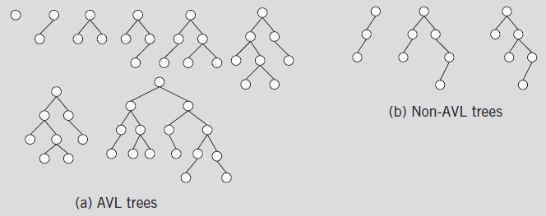

Slide 8
Insertion and Deletions
Operations on AVL trees (e.g., search) are implemented as binary trees, except insertion and deletions which may perform additional computations.
One more thing is associated with each node x in the AVL tree =>
balanceFactor = height(left subtree) - height(right subtree)
OR: balanceFactor = height(right subtree) - height(left subtree)
The balance factor of any node of an AVL tree is (-1,0, or +1).
The temporarily recomputed balance factor of a node after an insertion will be in the range [−2,+2].
After inserting a node, it is necessary to check each of the node's ancestors (in sequence, parent , grandparent etc) for consistency.
If a node is unbalanced, perform single or double rotation/reconstruction to correct balance.

Slide 9
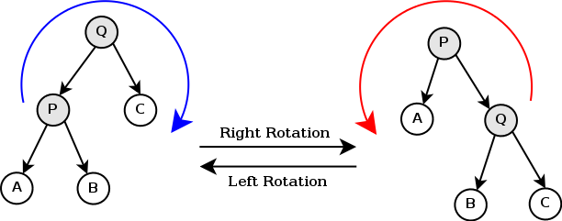
Tree rotation
An operation on a binary tree that changes the structure without interfering with the order of the elements.
A tree rotation moves one node or subtree up in the tree and one down.
It is used to change the shape of the tree, and in particular to decrease its height by moving smaller subtrees down and larger subtrees up, resulting in improved performance of many tree operations.

Slide 10
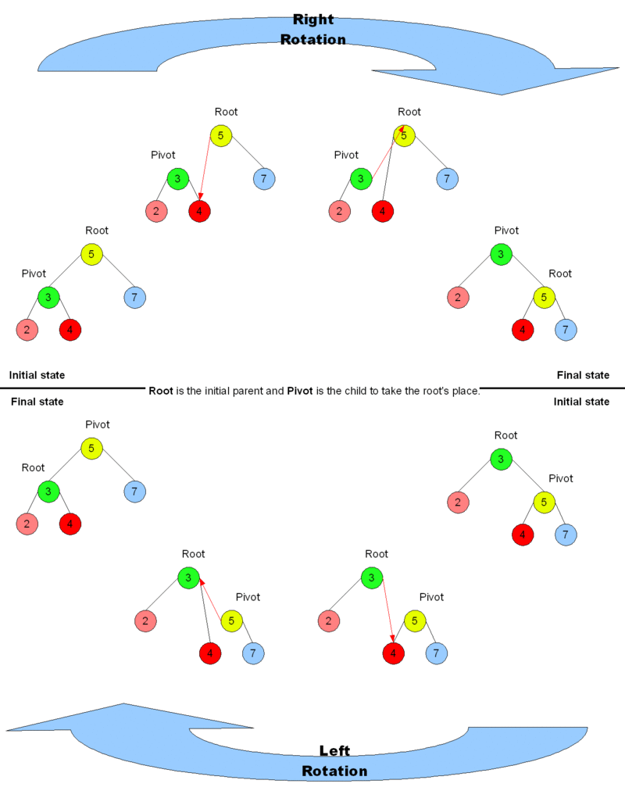

Slide 12
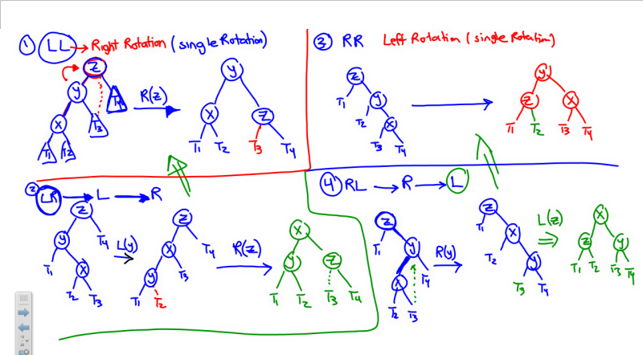

Slide 13
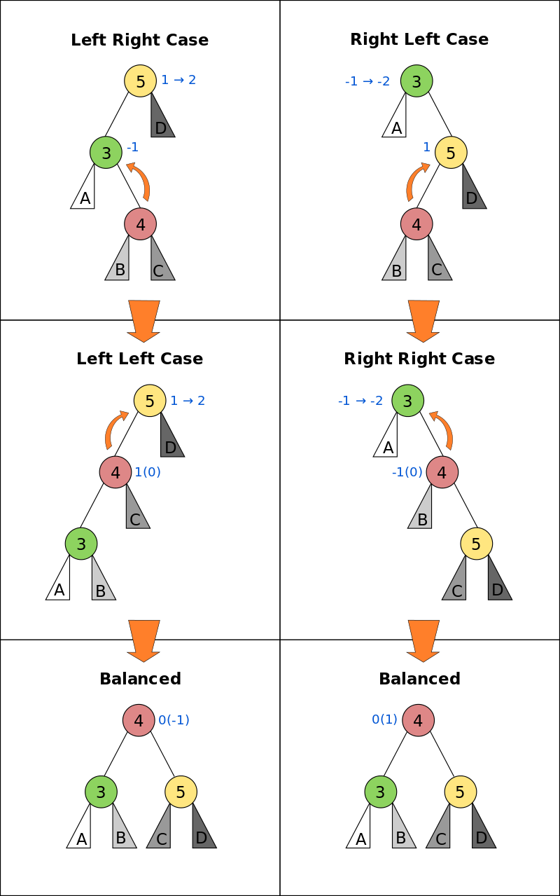
Summary:
LL -> R (node)
RR-> L (node)
LR-> L (subtree) -> R(node)
RL-> R (subtree) -> L(node)
A blue number next to a node denotes possible balance factors (those in parentheses occurring only in case of deletion).

Slide 14
Rotation steps
IF tree is right heavy (height differ by more than 1)
IF tree's right subtree is left(L) heavy (RL)
R rotation to the subtree and then L rotation to the node (double rotation)
ELSE IF tree's right subtree is right(R) heavy (RR)
L rotation to the unbalanced node (single rotation)
ELSE IF tree is left heavy
IF tree's left subtree is right heavy (LR)
L rotation to the subtree and then R rotation to the node (double rotation)
ELSE IF tree's left subtree is left heavy (LL)
R rotation to the unbalanced node (single rotation)
NOTE: During a rotation, the moved children must be connected to a parent and not another child.

Slide 15
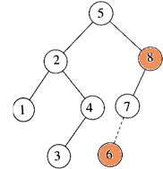
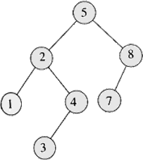
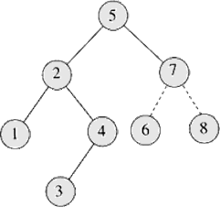
Insertion
Insert 6
Imbalance at 8 Perform rotation with 7

Slide 16


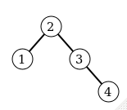
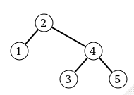
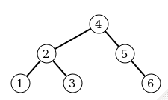
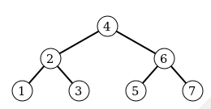
Insert 1, 2, 3, 4, 5, 6, 7 into an AVL Tree

Slide 17
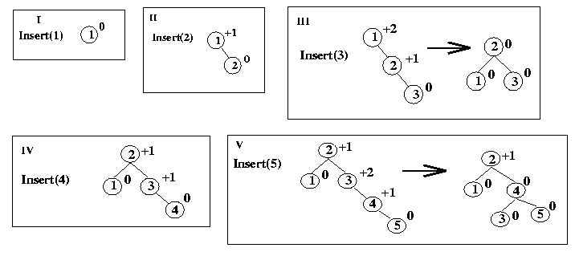
Insert 1, 2,3, 4, 5, 0,7, 6 into an AVL Tree

Slide 18
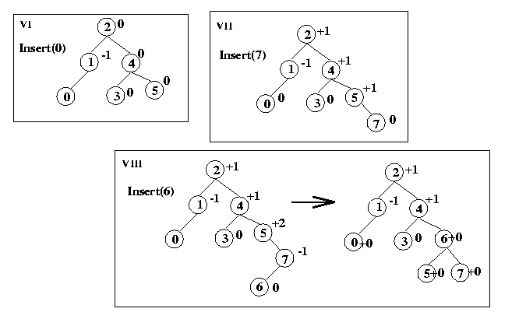

Slide 19
Example of insertion (with rotation): 20 40 60
.
20
20
40
40
40
20
60
60

Slide 20
Example of insertion (with rotation): 20 40 60 10 15
20
20
40
40
20
60
40
40
20
60
10
60
15
40
15
60
10
20
20

Slide 21
Example of insertion (with rotation) 20 40 60 10 15 12 11
.
20
20
40
40
20
60
40
40
20
60
10
60
15
40
40
15
15
60
15
60
10
40
10
20
10
20
12
20
60
12
15
15
10
40
11
40
12
20
60
10
12
20
60
11

Slide 22

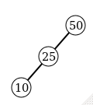
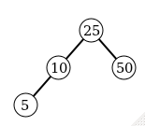
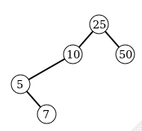
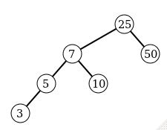

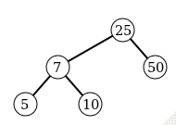
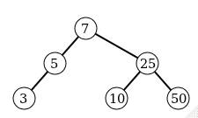
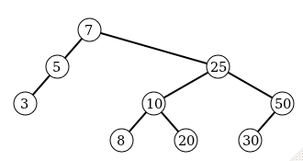
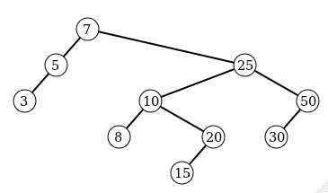
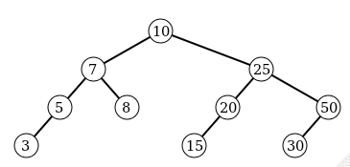
Insert 50, 25, 10, 5, 7, 3, 30, 20, 8, 15 into an AVL Tree

Slide 23
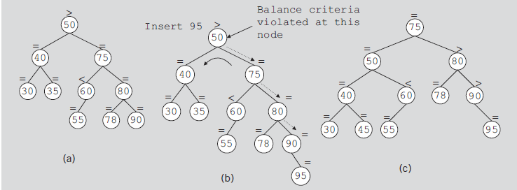
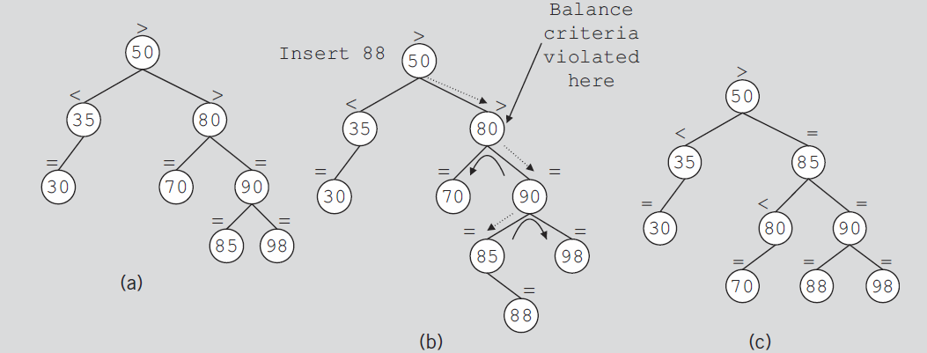

Slide 24
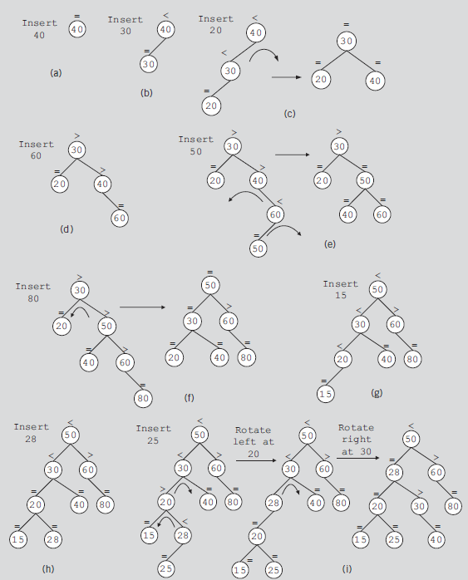
Insert 40, 30, 20, 60, 50, 80, 15, 28, 25 into an AVL Tree

Slide 25
Deletion from AVL Trees
We first do the normal BST deletion:
0 children: just delete it
1 child: delete it, connect child to parent
2 children: put predecessor/successor in your place, delete predecessor/successor
After deleting the node, the resulting tree might no longer be an AVL tree. As in the case of insertion into an AVL tree, and the “height” at the top could decrease or increase by 1.
Which nodes’ heights may have changed:
0 children: path from deleted node to root
1 child: path from deleted node to root
2 children: path from deleted successor leaf to root
Similar rotations to insert, but in case there is an imbalance at a node and the left subtree height is equal to right subtree height, then perform either rotation (single or double rotate).

Slide 26
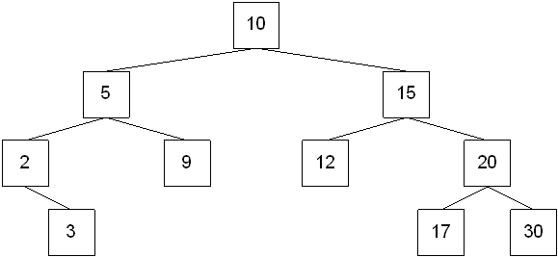
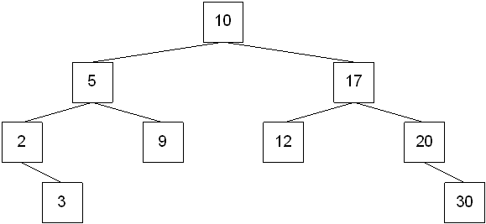
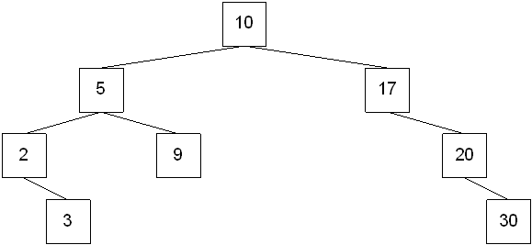
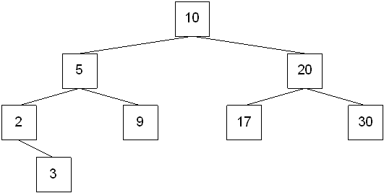
Delete 15 and 12 using INORDER SUCCESSOR logic
(1)
(2)
(3)
(4)

Slide 27
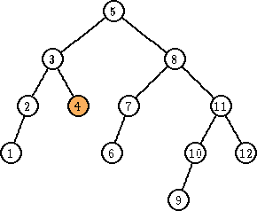
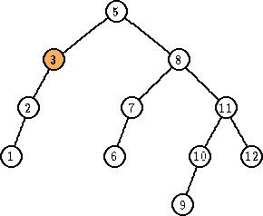
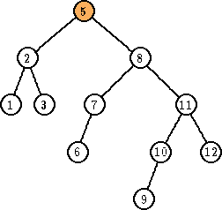
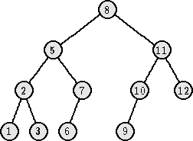
Deletion
Delete 4
Imbalance at 3
Perform rotation with 2
Imbalance at 5
Perform rotation with 8

Slide 28
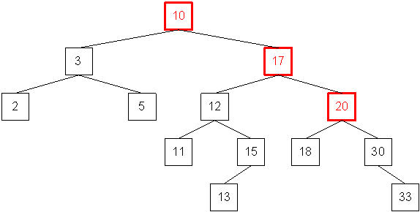
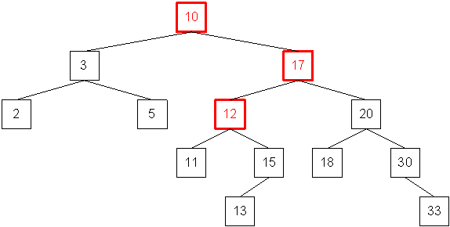
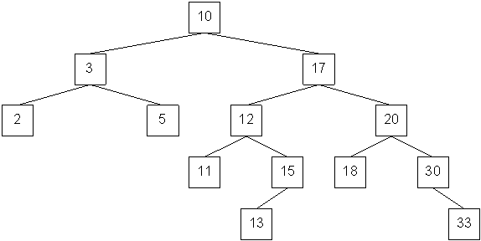
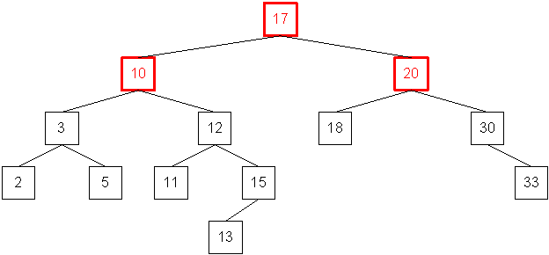
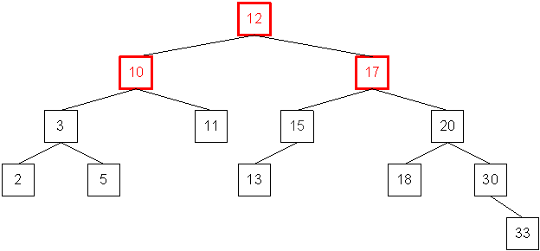
What type of rotation should be performed to fix the imbalance?
(1) A single left rotation with the highlighted nodes
(2) OR a right-left rotation with the highlighted nodes
After the single left rotation
After the right-left rotation

Slide 29
Pros and Cons of AVL Trees
Arguments for AVL trees:
Fast search, insert, delete operations because trees are always balanced.
The height balancing adds no more than a constant factor to the speed of insert and delete.
Arguments against AVL trees:
More space for height field
Rebalancing takes a little time -> slower than ordinary BST on random data
Most large searches are done in database-like systems on disk and use other structures (e.g., B-trees).

Slide 30
Useful links
AVL Tree animation
https://www.cs.usfca.edu/~galles/visualization/AVLtree.html
http://www.cs.armstrong.edu/liang/animation/web/AVLTree.html
AVL Tree Insertion https://www.youtube.com/watch?v=rbg7Qf8GkQ4
The AVL Tree Rotations Tutorial http://www.cise.ufl.edu/~nemo/cop3530/AVL-Tree-Rotations.pdf
AVL Tree insert algorithm http://www.geeksforgeeks.org/avl-tree-set-1-insertion/
AVL Tree delete algorithm http://www.geeksforgeeks.org/avl-tree-set-2-deletion/

Slide 31
Acknowledgment
Data Structures Using C++ 2nd ed, D. S. Malik, 2009, Chapter 11 – AVL Trees.
Data Structures and Algorithms in C++ (2rd ed.), Michael T. Goodrich, Roberto Tamassia, David M. Mount, 2011, John Wiley & Sons. Chapter 10.2 – AVL Trees.
Prof. Sin-Min Lee AVL notes http://www.cs.sjsu.edu/faculty/lee/cs146/cs146.htm
Prof. Freeman AVL notes http://faculty.cs.niu.edu/~freedman/340/340notes/340avl2.htm
Prof. Zohu AVL notes
Dan Grossman AVL notes http://courses.cs.washington.edu/courses/cse332/10sp/lectures/lecture8.pdf
https://en.wikipedia.org/wiki/AVL_tree

